Slide 1
MVC Pattern
Mahesh Shirole
VJTI, Mumbai -19.

Slide 2
Introduction
The programming language Smalltalk first defined the MVC concept it in the 1970’s
The MVC pattern was first described in 1979 by Trygve Reenskaug, then working on Smalltalk at Xerox research labs
It is an extension of the layered Architecture
It has three main layers:
presentation (UI),
Presentation layer is split into controller and view
application logic,
resource management
Separation of concerns
between presentation and application logic

Slide 3
Example Problem
Consider a simple information system for political elections with proportional representation.
This offers a spreadsheet for entering data and several kinds of tables and charts for presenting the current results.
Users can interact with the system via a graphical interface.
All information displays must reflect changes to the voting data immediately.

Slide 4
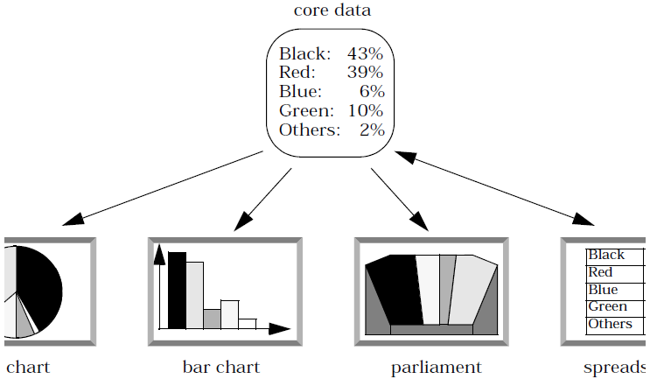
Example Problem
The system should also be portable to platforms with different ‘look and feel’ standards
Interactive applications with a flexible human-computer interface

Slide 5
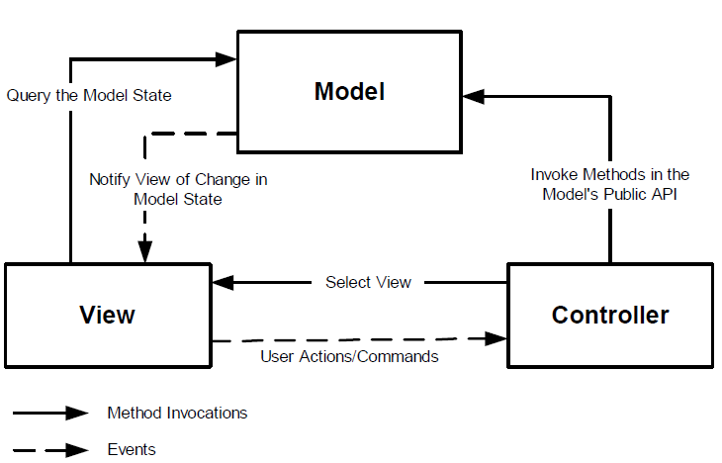
MVC Architecture

Slide 6
MVC Architecture
Model
The domain-specific representation of the information on which the application operates
The model is another name for the application logic layer (sometimes also called the domain layer)
Application (or domain) logic adds meaning to raw data (e.g., calculating if today is the user’s birthday, or the totals, taxes and shipping charges for shopping cart items)
Many applications use a persistent storage mechanism (such as a database) to store data
MVC does not specifically mention the resource management layer because it is understood to be underneath or encapsulated by the Model

Slide 7
MVC Architecture
View
Renders the model into a form suitable for interaction, typically a user interface element
The view modifies itself when a change in the model is communicated to the view
A view forwards user input to the controller
As the presentation semantics are encapsulated within the view, therefore model data can be adapted for several different kinds of clients
MVC is often seen in web applications, where the view is the HTML page and the code which gathers dynamic data for the page

Slide 8
MVC Architecture
Controller
Processes and responds to events, typically user actions, and may invoke changes on the model and view
The controller is responsible for intercepting and translating user input into actions to be performed by the model
The controller is responsible for selecting the next view based on user input and the outcome of model operations

Slide 9
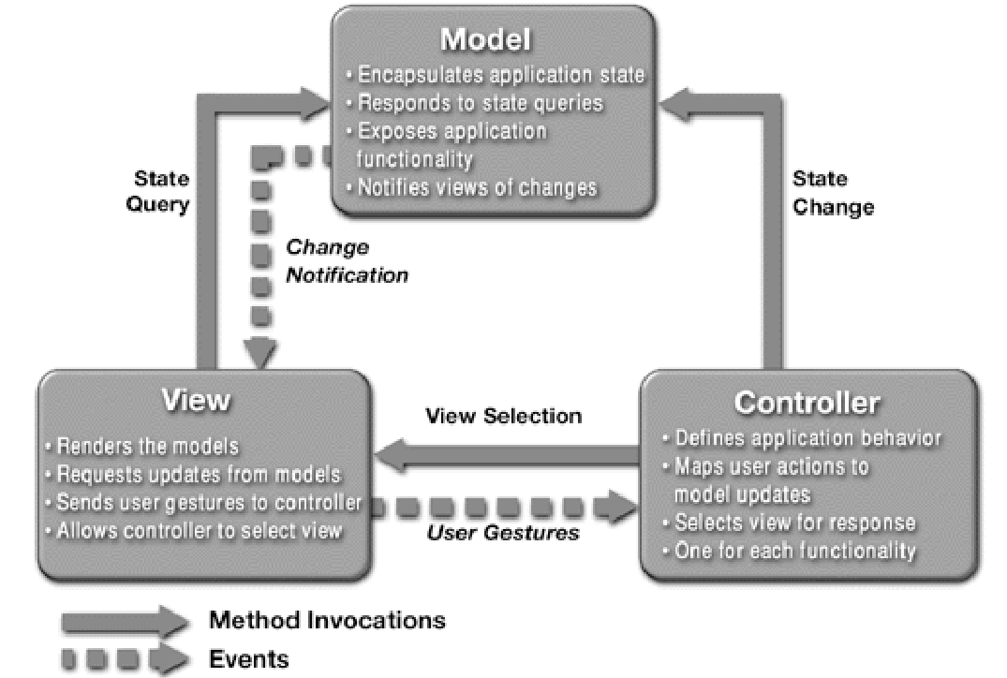
MVC Architecture

Slide 10
MVC Interaction
The user interacts with the user interface in some way (e.g., user presses a button)
A controller handles the input event from the user interface, often via a registered handler or call-back
The controller accesses the model, possibly updating it in a way appropriate to the user’s action (e.g., controller updates user’s shopping cart). Complex controllers are often structured using the command pattern to encapsulate actions and simplify extension.
A view uses the model to generate an appropriate user interface (e.g., view produces a screen listing the shopping cart contents). The view gets its own data from the model. The model has no direct knowledge of the view. (However, the observer pattern can be used to allow the model to indirectly notify interested parties, potentially including views, of a change.)
The user interface waits for further user interactions, which begins the cycle anew.

Slide 11
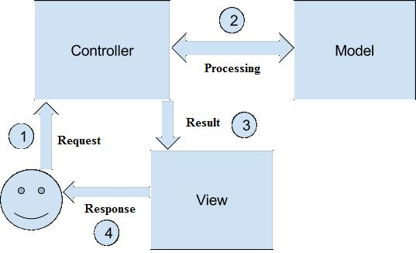
MVC Architecture Interactios

Slide 12
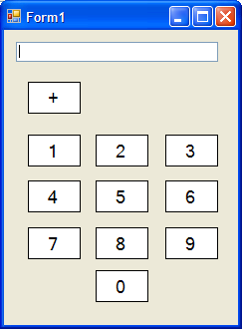
Submission Tutorial: 04
Extend calculator program to implement MVC architecture. Design JFame to create view, use basic calculator as model and, create appropriate controller.
Use second view as web page, third view as command line. Update calculation from any view and display result string in all views

